Slide 1
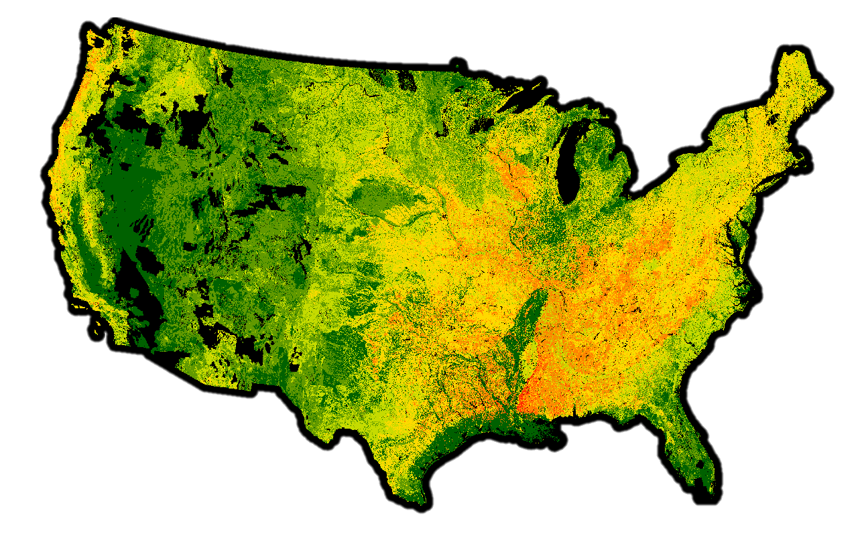
Soil Vulnerability Index for
Nutrient-Runoff
Notes:
https://jneme910.github.io/SVI-Nutrient-Runoff/

Slide 2
Problem Statement:
Conservation Desktop (CD) and Conservation Assessment Ranking Tool (CART) would like to present "interpretation" soil maps and tabular results based upon both soils and non-soils spatial data sources. This is not feasible with the current implementation of "Soil Data Access" (SDA) Web services.
Notes:
Conservation Desktop (CD) and Conservation Assessment Ranking Tool (CART) would like to present "interpretation" soil maps and tabular results based upon both soils and non-soils data sources. This is not feasible with the current implementation of "Soil Data Access" (SDA) Web services.

Slide 3

Why?
Notes:
About SVI – Nutrient Runoff
Identify inherent vulnerability of cropland to runoff and leaching
Why
Larger dead zones in the Gulf of Mexico
Help conservation planners identify vulnerable areas within land units for nutrient runoff
To support NRCS conservation planners in their work with clients. Assist conservation planners as they analyze existing resource conditions, assess site vulnerability, and formulate and evaluate alternative actions

Slide 4
Code Fest experiment :
Combine a new data source, accessible as a "view" within the soil data mart database, with the appropriate SQL query(ies) to yield interpretation values by soil type (i.e., "map units").
Add additional queries to define associated colors and legends, then present the map image and tabular results in a Web page.

Slide 5
Success of this experiment :
Opens the door to map creation for new “interpretations” that are not immediately available as part of Web Soil Survey or Soil Data Access Web applications.
Notes:
Opens the door to map creation for new “interpretations” that are not immediately available as part of Web Soil Survey or Soil Data Access Web applications.

Slide 6
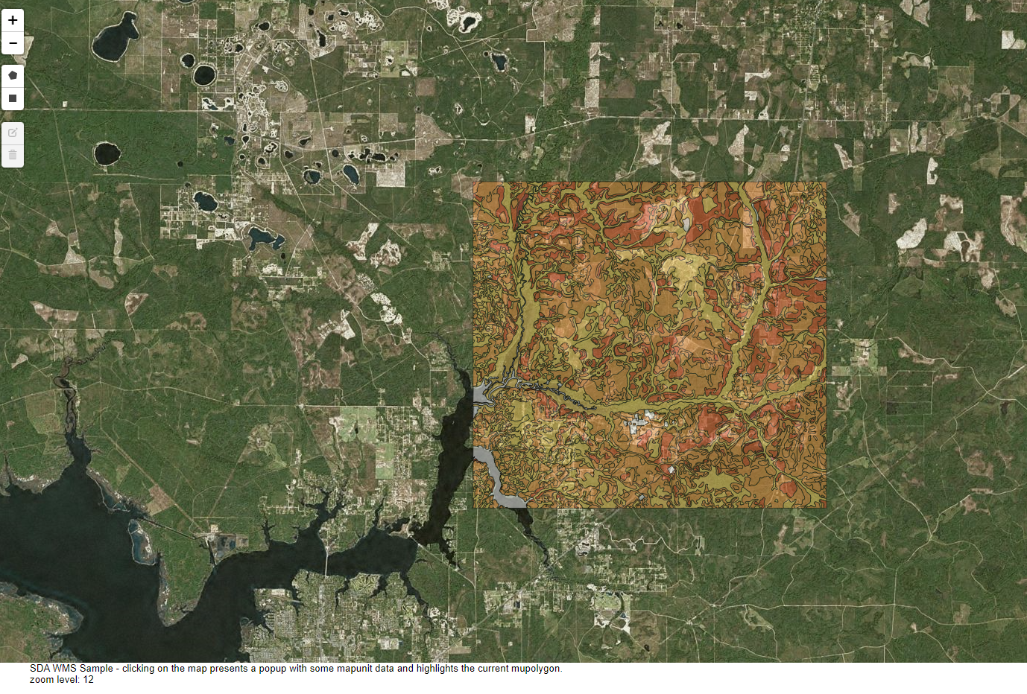

Slide 7
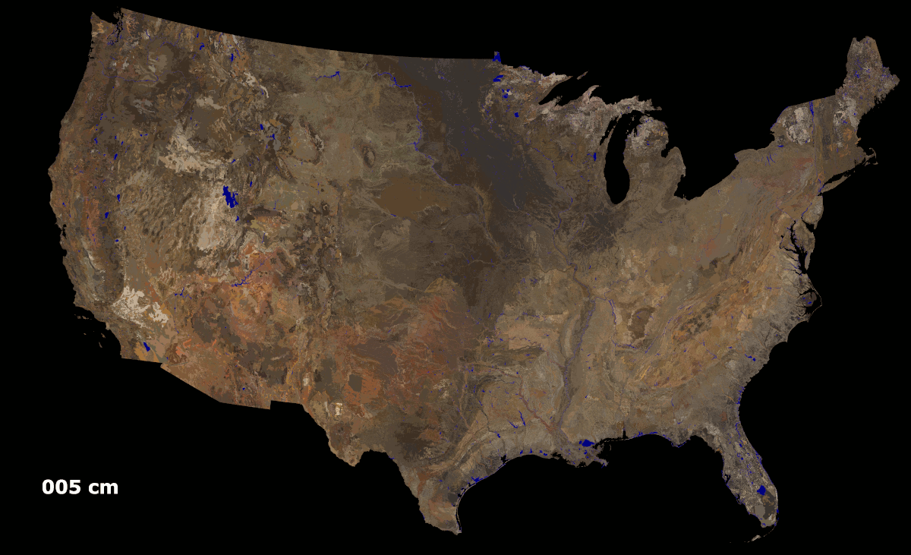
Questions?
Notes:
Consider adjusting figure brightness if too dim.

